Slide 1
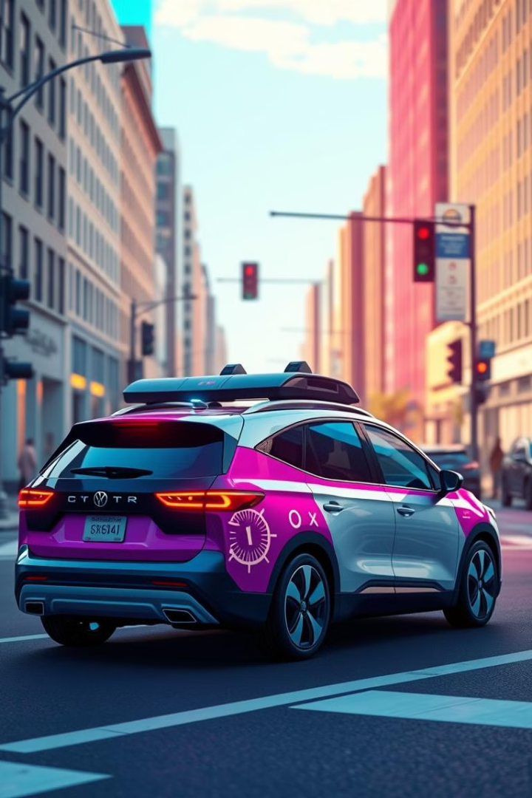

From Indoor Prototypes to Robust Outdoor Autonomy: A Comprehensive Analysis of State-of-the-Art SLAM Algorithms
Welcome to this presentation on the evolution of Simultaneous Localization and Mapping (SLAM) algorithms. We will explore the key principles, cutting-edge techniques, and emerging trends in this dynamic field, focusing on the challenges and opportunities of applying SLAM to large-scale outdoor environments.
by Muhammad Zeeshan Asghar

Slide 2
Agenda
1
Introduction
2
Foundational Principles
Overview of SLAM and its applications
Key concepts behind SLAM, including factor graphs and architecture.
3
State-of-the-Art Algorithms
4
Advanced Frontiers
Deep dive into prominent SLAM approaches: ORB-SLAM2, LOAM, and VINS-Fusion.
Exploring emerging trends like direct methods, semantic SLAM, and learning-based enhancements.
5
Comparative Analysis
6
Persistent Challenges & Future Directions
Evaluating the strengths and weaknesses of different SLAM methods.
Analyzing current limitations and potential future advancements.
7
Conclusion
Summarizing key insights and future directions in SLAM.

Slide 3
Introduction to SLAM
Definition
Applications
Evolution
Outdoor Challenges
Simultaneous Localization and Mapping (SLAM) enables autonomous agents to build maps of unknown environments while simultaneously determining their own positions within those maps.
SLAM is used in a wide range of applications, including self-driving cars, drones, field robots, and exploration rovers, to enable autonomous navigation and exploration.
SLAM has evolved from controlled indoor scenarios to more complex large-scale outdoor environments, where it faces unique challenges.
Outdoor SLAM presents challenges such as extended ranges, sparse features, dynamic objects, varying illumination, and unpredictable weather conditions.

Slide 4




Importance of SLAM in Autonomous Navigation
Real-time Navigation
SLAM provides essential information for real-time navigation and decision-making, allowing autonomous agents to understand their surroundings and plan their routes.
Autonomous Operations
It is fundamental for autonomous operations in unstructured environments, enabling agents to map and explore unknown terrains.
System Integration
SLAM can be seamlessly integrated with other systems, such as obstacle avoidance and path planning, for comprehensive autonomous capabilities.

Slide 5
Foundational Principles of SLAM
Factor Graphs
Modular Architecture
Loop Closure
Factor graphs represent SLAM problems as a network of interconnected nodes (poses and map features) and edges (sensor measurements). This structure efficiently captures relationships and constraints between variables.
SLAM algorithms typically follow a modular front-end/back-end architecture. The front-end processes sensor data, extracts features, and detects loop closures, while the back-end optimizes the global map and pose estimates.
Loop closure detection plays a crucial role in SLAM, by identifying and correcting drift in the estimated robot trajectory as it revisits previously explored areas.

Slide 6
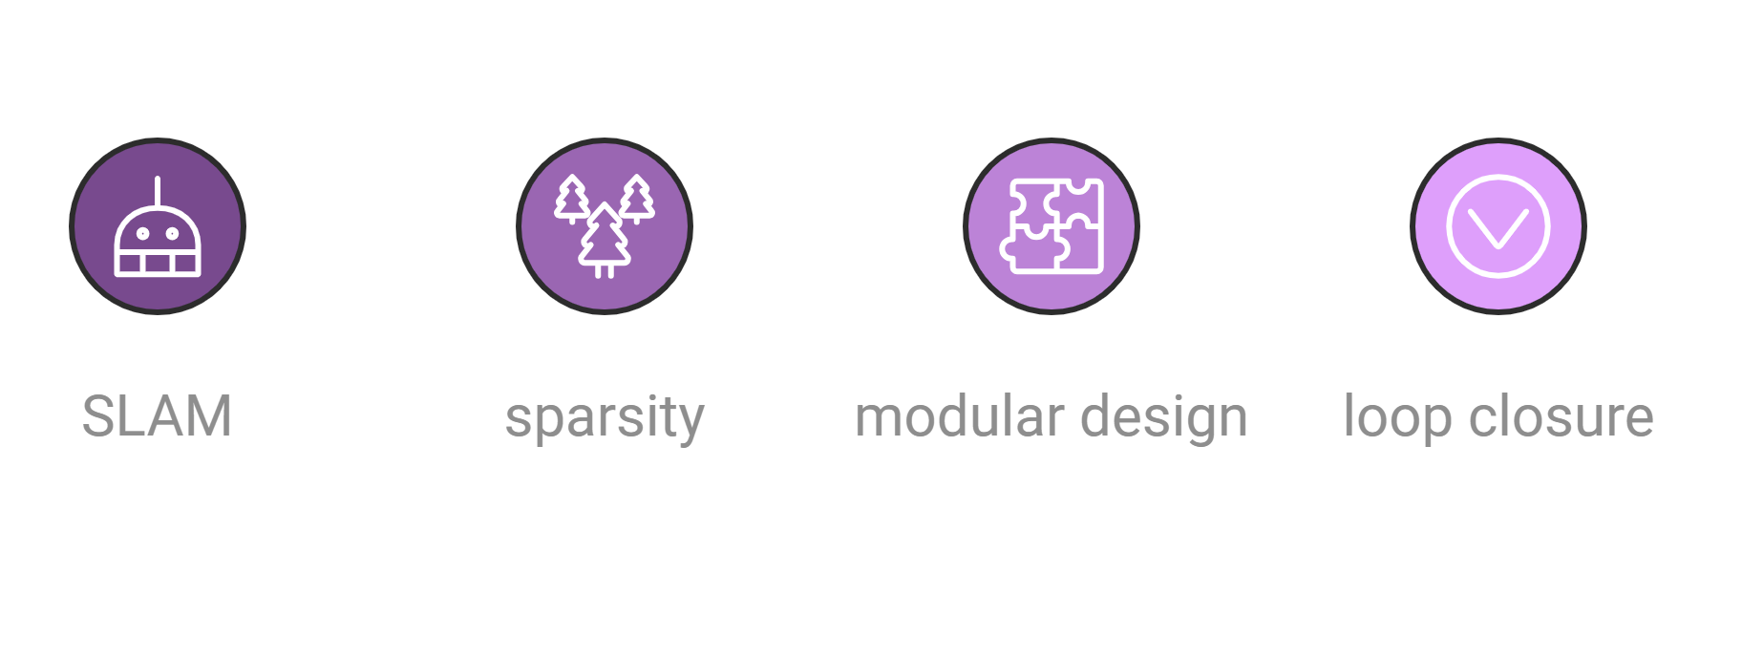


Key Insights from Foundational Principles
Sparsity Exploitation
Modular Design
Robust Loop Closure
Factor graphs exploit the sparsity of SLAM problems, allowing efficient management of large maps and optimized computational complexity.
The modular architecture of SLAM facilitates the integration of various sensors and allows independent advancements in different components.
Reliable loop closure mechanisms are essential for maintaining global map consistency and reducing drift in the estimated robot trajectory.

Slide 7




ORB-SLAM2: Overview
Real-time Performance
1
Achieves real-time performance without relying on a GPU, making it suitable for resource-constrained platforms.
Efficient Features
2
Leverages ORB features for fast and robust feature detection and matching.
Triple-Threaded Architecture
3
Runs three parallel threads for tracking, local mapping, and loop closing, optimizing resource utilization.
Loop Closure Mechanism
4
Provides a reliable loop closure detection mechanism based on bag-of-words for global map consistency.

Slide 8
ORB-SLAM2: Algorithmic Highlights
Fast Binary Descriptors (ORB)
1
ORB features combine the speed of FAST (Features from Accelerated Segment Test) with the robustness of BRIEF (Binary Robust Independent Elementary Features).
Three-Threaded Pipeline
2
The tracking thread estimates the camera pose, the local mapping thread performs bundle adjustment and adds keyframes, and the loop closing thread detects loop closures and refines the global map.
Robust Loop Closure Detection
3
ORB-SLAM2 uses a bag-of-words approach to detect loop closures, ensuring global map consistency and reducing drift.

Slide 9
LOAM: Leveraging LiDAR for Outdoor SLAM
Motivation
1
LOAM (Lidar Odometry and Mapping) leverages LiDAR for stable and accurate outdoor SLAM, addressing challenges associated with varying illumination and providing precise 3D measurements.
2
Key Features
LOAM extracts geometric features (edges and planes) from LiDAR data, utilizes decoupled odometry and mapping threads, and employs robust registration cost functions.
Geometric Feature Extraction
3
LOAM efficiently extracts sharp edges and planar surfaces from LiDAR data, reducing computational load and improving data association.
4
Decoupled Threads
LOAM separates odometry estimation (real-time incremental motion estimation) from mapping (global map refinement and drift reduction), enabling parallel processing.
Robust Registration Cost Functions
5
LOAM uses robust registration cost functions based on point-to-line and point-to-plane distances for stable and convergent optimization.

Slide 10
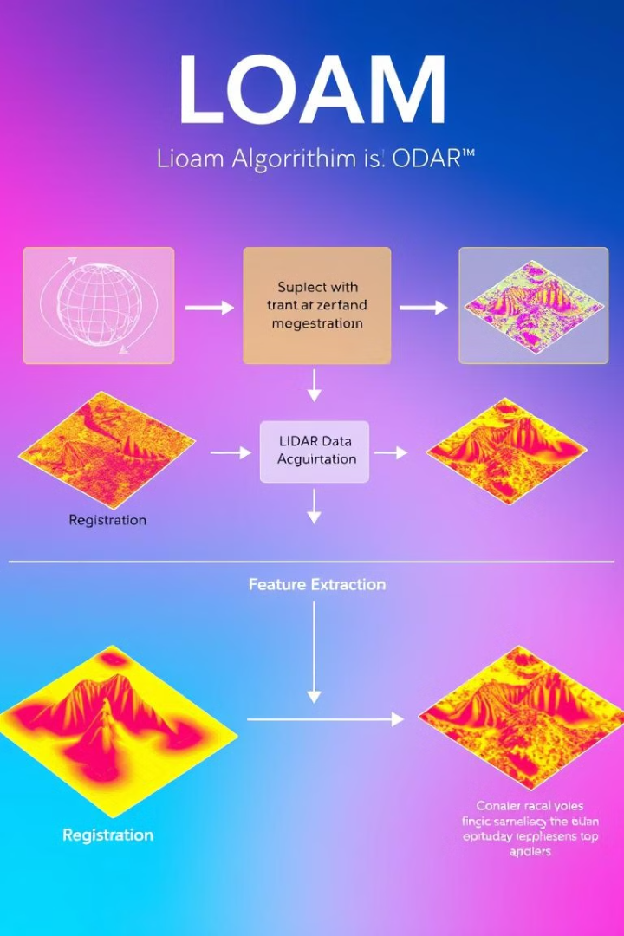
LOAM: Algorithmic Highlights
1
2
Feature Extraction
Odometry Estimation
LOAM extracts geometric features from LiDAR data, such as edges and planes, which are used for robust registration and pose estimation.
The odometry thread in LOAM estimates the robot's pose incrementally using these extracted features and LiDAR scans.
3
4
Mapping
Registration Cost Functions
The mapping thread refines the global map and reduces drift by integrating new measurements and correcting accumulated errors.
LOAM employs robust registration cost functions based on point-to-line and point-to-plane distances to minimize registration errors and enhance stability.

Slide 11
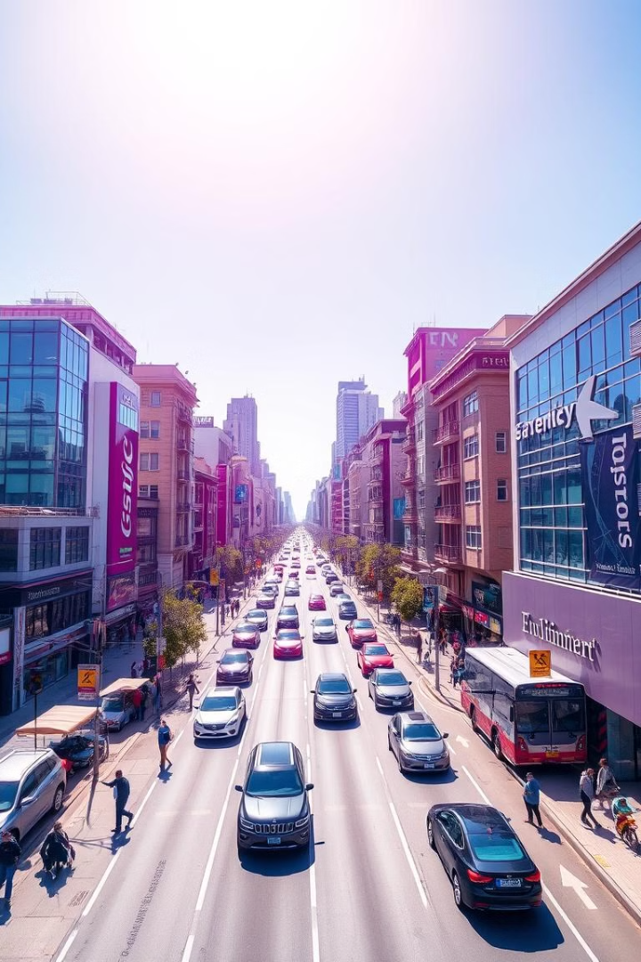
A Deep Dive into Multi-Sensor Integration and Emerging Frontiers
We will now delve into the innovative approaches that are driving progress in outdoor SLAM, focusing on multi-sensor fusion and emerging frontiers like direct visual methods and learning-based techniques.

Slide 12
VINS-Fusion: Robustness Through Multi-Sensor Integration
Context
Significance
VINS-Fusion, a leading SLAM framework, leverages multi-sensor fusion to enhance robustness and accuracy.
By integrating visual, inertial, and optional LiDAR data, VINS-Fusion achieves highly reliable localization and mapping.

Slide 13
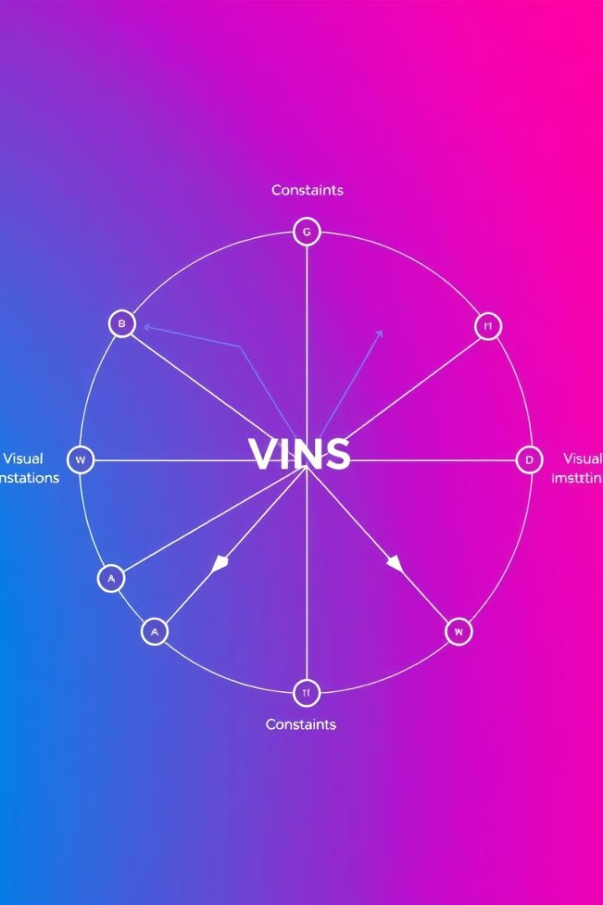
VINS-Fusion: Algorithmic Highlights
1
Tightly-Coupled Fusion
2
IMU Preintegration
IMU preintegration efficiently summarizes high-frequency IMU data, reducing computational burden.
VINS-Fusion optimizes all sensor constraints within a unified factor graph.
3
LiDAR Integration
Optional LiDAR integration enhances accuracy in feature-sparse or unreliable visual environments.

Slide 14
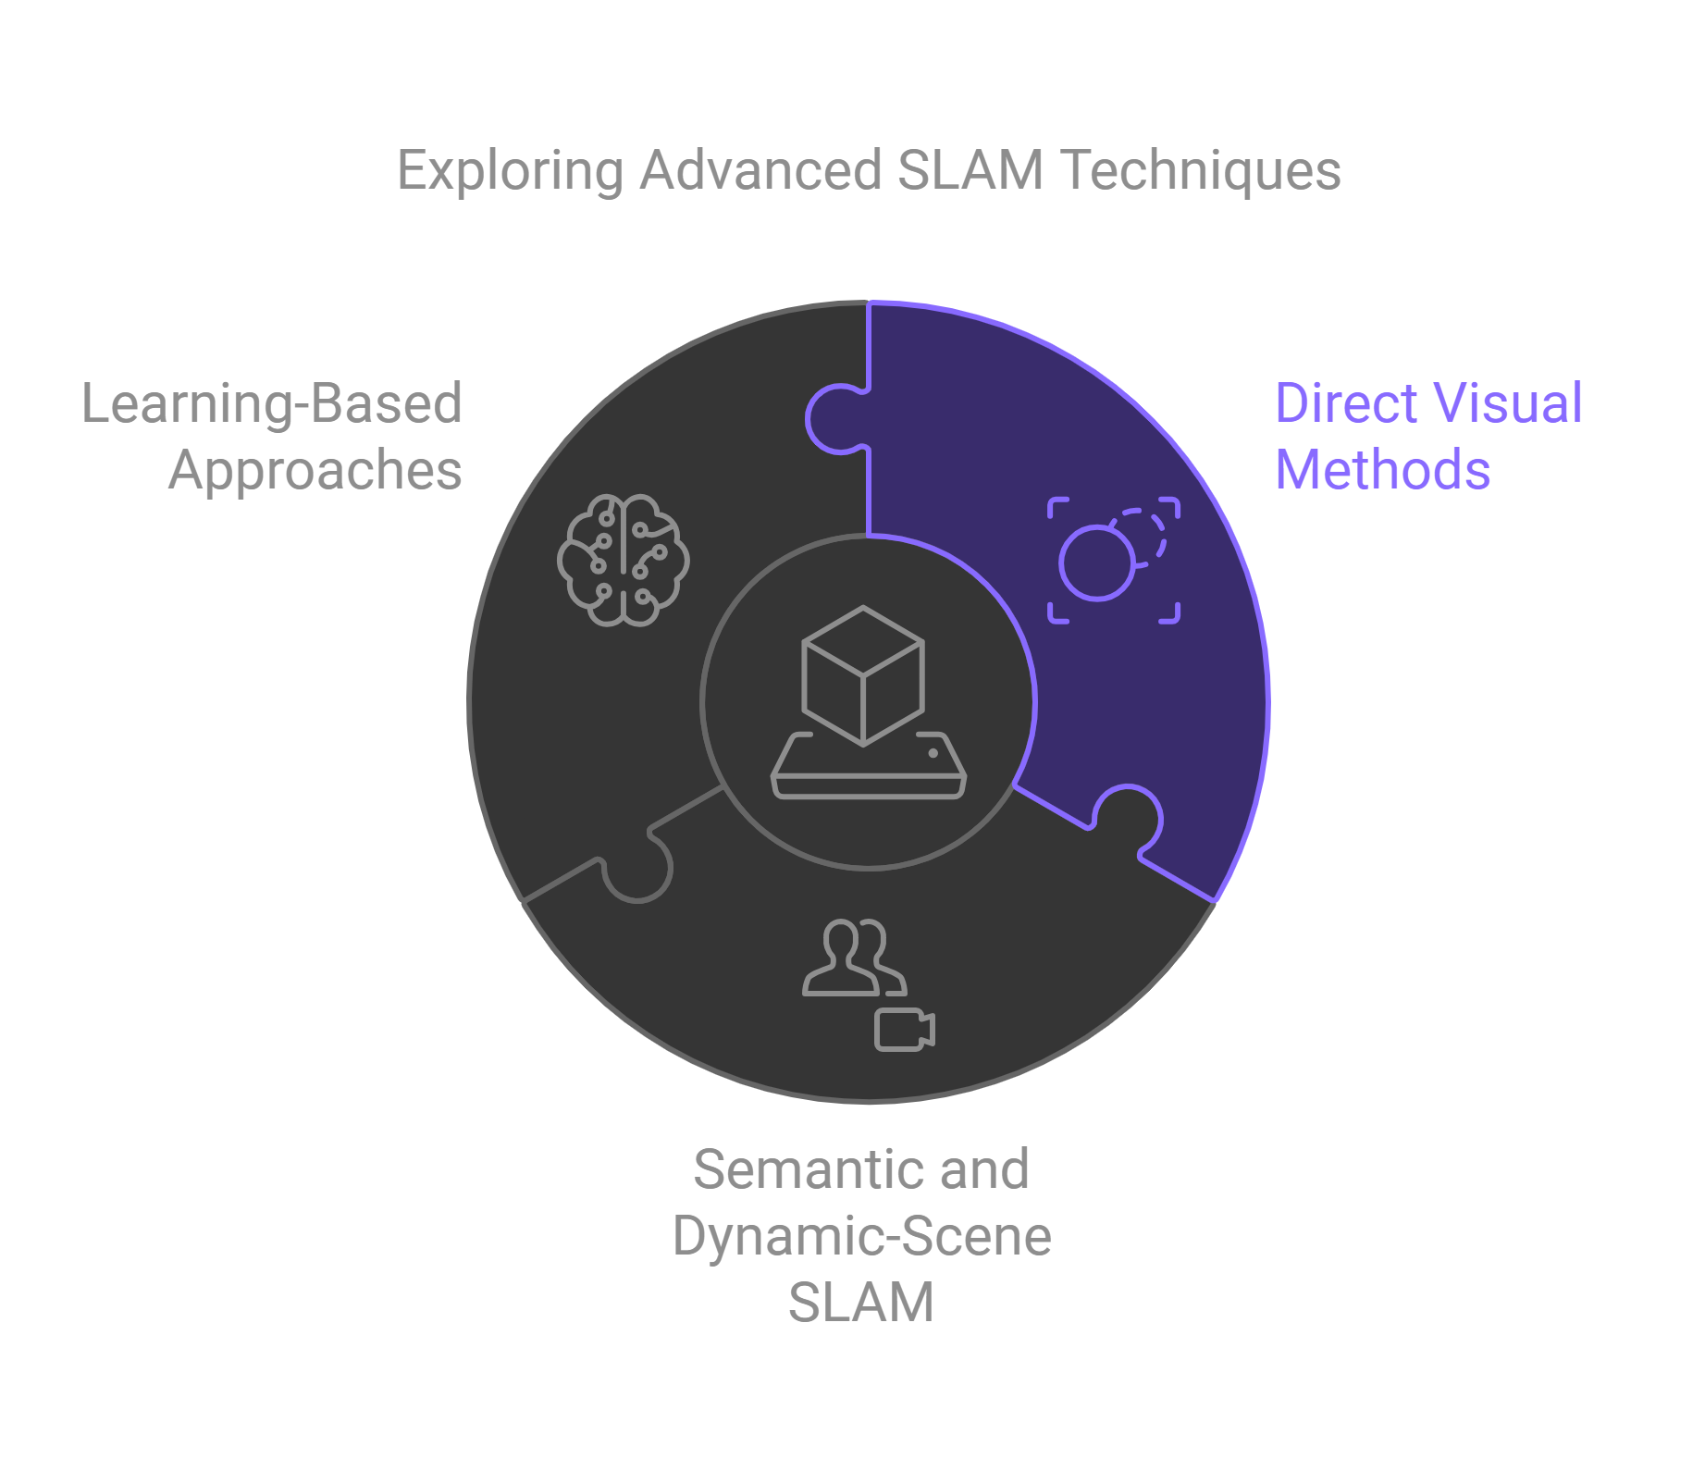
Advanced Frontiers in SLAM: Beyond Traditional Methods
Direct Visual Methods
Semantic and Dynamic-Scene SLAM
LSD-SLAM and DSO optimize directly on pixel intensities, achieving robustness and dense mapping.
DynaSLAM incorporates semantic segmentation, handling dynamic objects and improving map consistency.
Learning-Based Approaches
SuperGlue and DeepVO utilize neural networks for feature matching and motion estimation, offering higher accuracy and efficiency.

Slide 15
Direct Visual Methods: LSD-SLAM and DSO
Photometric Error Minimization
Semi-Dense or Dense Mapping
Direct methods align images based on pixel intensities, handling illumination changes with robust models.
LSD-SLAM and DSO provide richer geometric detail compared to sparse feature-based methods.

Slide 16
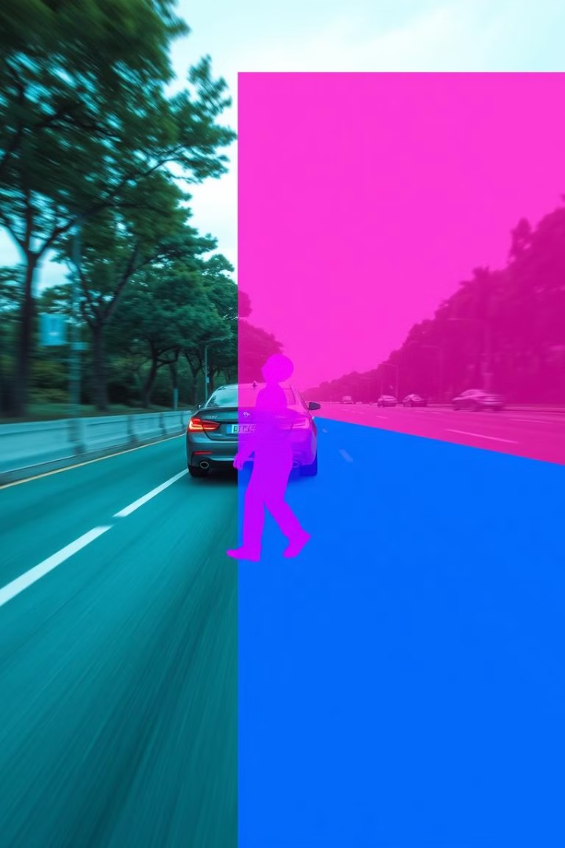


Semantic and Dynamic-Scene SLAM: DynaSLAM
Semantic Segmentation
Loop Closure
DynaSLAM utilizes deep learning (e.g., Mask R-CNN) to identify dynamic objects, enhancing map consistency.
Focusing on static landmarks reduces false loop closures, leading to more accurate and reliable maps.

Slide 17
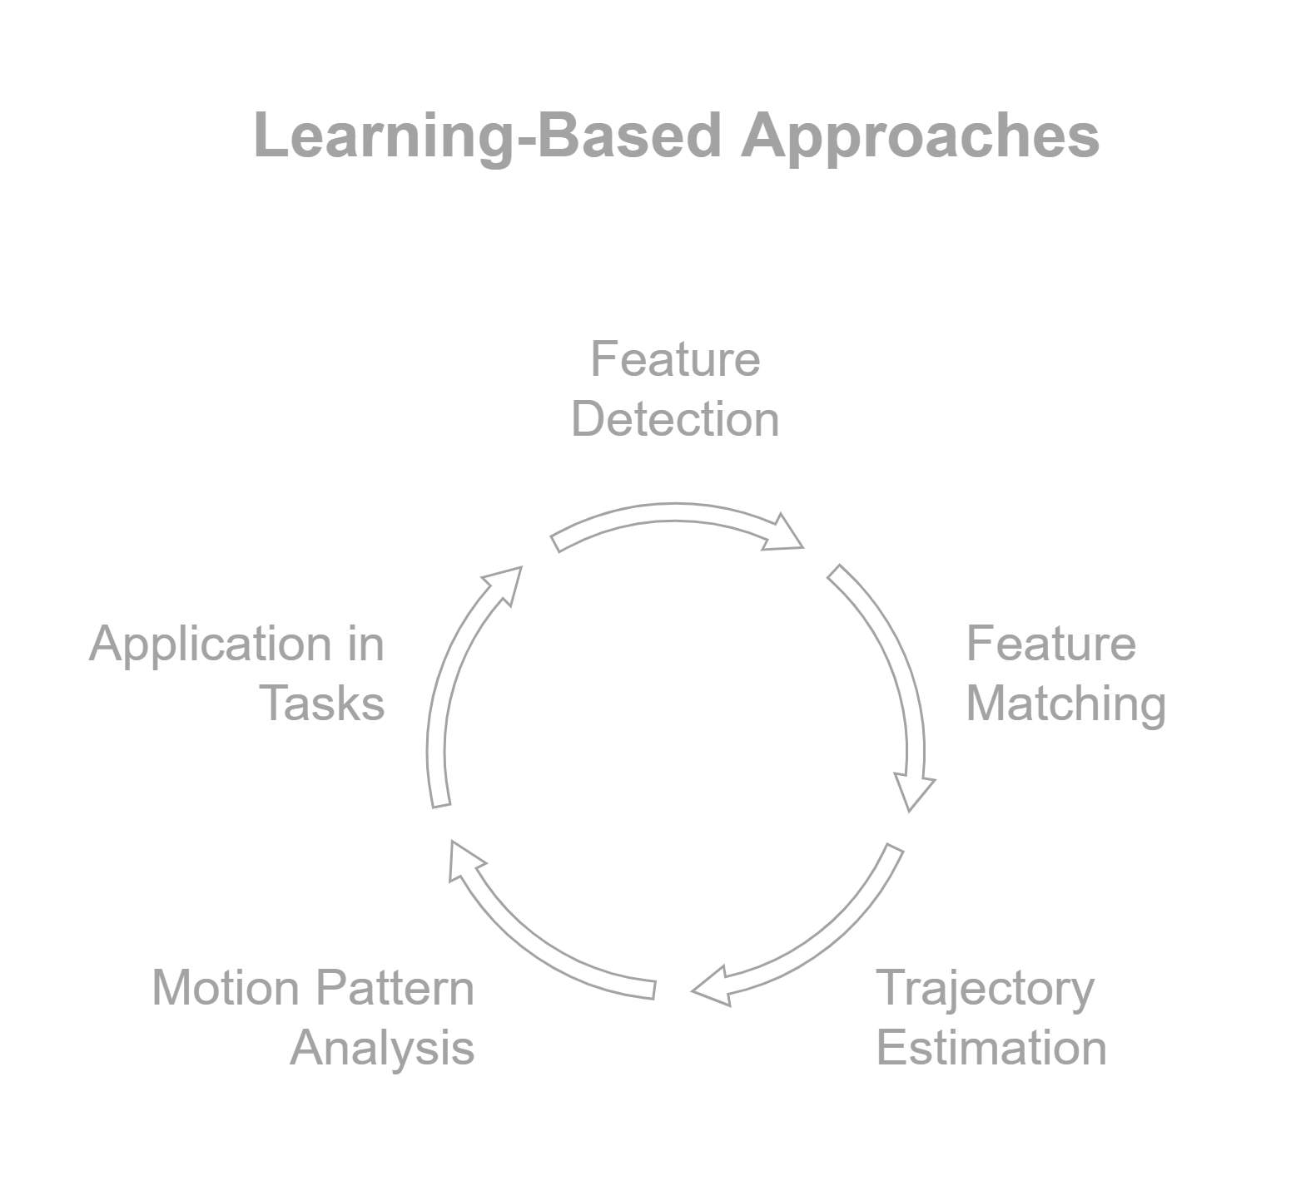
Learning-Based Approaches: SuperGlue and DeepVO
1
SuperGlue
SuperGlue employs graph neural networks for feature matching, ensuring mutual consistency and global coherence.
2
DeepVO
DeepVO performs end-to-end visual odometry using deep recurrent convolutional networks, capturing complex motion patterns.

Slide 18
Comparative Analysis of SLAM Methods
Method
Sensors
Core Idea
Strengths
Limitations
Outdoor Suitability
VINS-Fusion
Visual, Inertial, LiDAR
Tightly-coupled multi-sensor fusion
Robustness, accuracy
Computational complexity
High
LSD-SLAM
Visual
Direct visual optimization
Dense mapping, illumination invariance
Computational cost
Medium
DSO
Visual
Direct visual optimization
Semi-dense mapping, real-time performance
Sensitivity to textureless environments
Medium
DynaSLAM
Visual, Semantic
Semantic segmentation for dynamic filtering
Enhanced loop closure, robust mapping
Computational requirements for semantic segmentation
Medium
SuperGlue
Visual
Learned feature matching
High accuracy, global coherence
Requires training data
High
DeepVO
Visual
End-to-end visual odometry
Handles complex motion, real-time performance
Requires large datasets for training
High

Slide 19





Persistent Challenges and Future Directions in Outdoor SLAM
1
Dynamic Scenes
2
Lifelong Operation
3
Weather Invariance
4
Scalability
5
Novel Sensors
Addressing these challenges will lead to advancements in robust outdoor SLAM, enabling the development of intelligent robots that can navigate complex and dynamic environments.

Slide 20
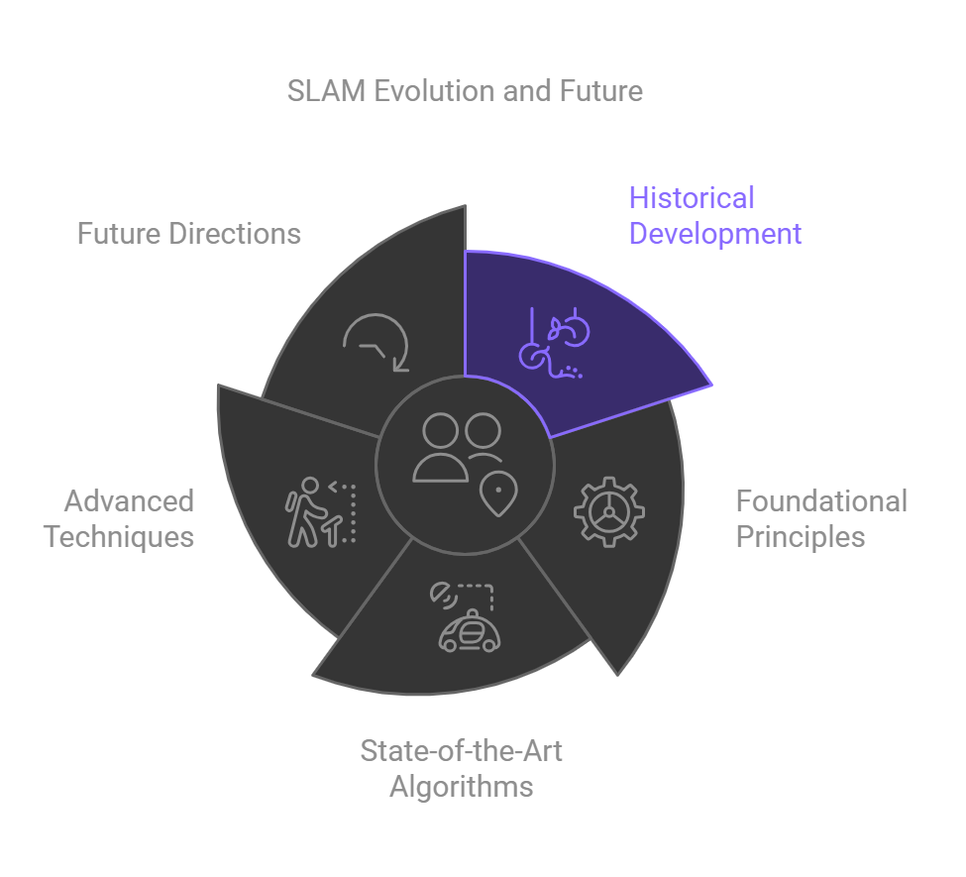
Conclusion
Summary:
Evolution of SLAM from indoor to large-scale outdoor environments.
Foundational principles underpinning modern SLAM systems.
Analysis of state-of-the-art algorithms: ORB-SLAM2, LOAM, VINS-Fusion.
Advanced techniques addressing specific outdoor challenges.
Ongoing challenges and promising future research directions.
Final Thought:
SLAM remains critical for the advancement of autonomous systems, requiring continued innovation to meet the demands of real-world, dynamic, and large-scale environments.

Slide 21
References
[1] R. Mur-Artal, J. Montiel, and J.D. Tardós, “ORB-SLAM: A versatile and accurate monocular SLAM system,” IEEE Transactions on Robotics, vol. 31, no. 5, pp. 1147–1163, 2015. [2] J. Zhang and S. Singh, “LOAM: Lidar Odometry and Mapping in Realtime,” Robotics: Science and Systems (RSS), 2014. [3] T. Qin, P. Li, and S. Shen, “VINS-Fusion: A versatile and robust multi-sensor fusion framework for visual-inertial state estimation,” IEEE Transactions on Robotics, vol. 34, no. 4, pp. 1004–1020, 2018. [4] J. Engel, T. Schöps, and D. Cremers, “LSD-SLAM: Large-scale direct monocular SLAM,” European Conference on Computer Vision (ECCV), 2014. [5] J. Engel, V. Koltun, and D. Cremers, “Direct Sparse Odometry,” IEEE Transactions on Pattern Analysis and Machine Intelligence, vol. 40, no. 3, pp. 611–625, 2018. [6] B. Bescós, J. Neira, R. Mur-Artal, and J.D. Tardós, “DynaSLAM: Tracking, mapping, and inpainting in dynamic scenes,” IEEE Transactions on Robotics, vol. 36, no. 6, pp. 2032–2038, 2020. [7] P. Sarlin, D. DeTone, T. Malisiewicz, and A. Rabinovich, “SuperGlue: Learning feature matching with graph neural networks,” Conference on Computer Vision and Pattern Recognition (CVPR), 2020. [8] S. Wang, R. Clark, H. Wen, and N. Trigoni, “DeepVO: Towards end-to-end visual odometry with deep recurrent convolutional neural networks,” IEEE International Conference on Robotics and Automation (ICRA), 2017. [9] G. Klein and D. Murray, “Parallel tracking and mapping for small AR workspaces,” International Symposium on Mixed and Augmented Reality (ISMAR), 2007. [10] F. Dellaert, “Factor Graphs and GTSAM: A hands-on introduction,” Technical Report, 2012. [11] A. Rosinol, M. Abate, Y. Chang, and L. Carlone, “Kimera: an open-source library for real-time metric-semantic localization and mapping,” IEEE International Conference on Robotics and Automation (ICRA), 2020. [12] A. Geiger, P. Lenz, and R. Urtasun, “Are we ready for autonomous driving? The KITTI vision benchmark suite,” Conference on Computer Vision and Pattern Recognition (CVPR), 2012. [13] R. Kümmerle et al., “g2o: A general framework for graph optimization,” IEEE International Conference on Robotics and Automation (ICRA), 2011. [14] J.T. Barron, B. DeTone, A. Dusmanu, and C. Sweeney, “CodeSLAM: Learning a Compact, Optimizable Representation for Dense Visual SLAM,” Conference on Computer Vision and Pattern Recognition (CVPR), 2018. [15] Z. Zhi, J. Dong, K. Guo, M. Gharbi, T. Funkhouser, and Q. Huang, “NICE-SLAM: Neural Implicit Scalable Encoding for SLAM,” Conference on Computer Vision and Pattern Recognition (CVPR), 2022.

